Slide 1
Unit - 1
Data Manipulation with Pandas

Slide 2
Objective
Data Manipulation with Pandas
Introduction to Pandas Objects
Pandas Series Object
Pandas DataFrame Object
Data Storage Format
Reading data from file
Load CSV file to Pandas
Groupby Function
Pandas Data visualization

Slide 3

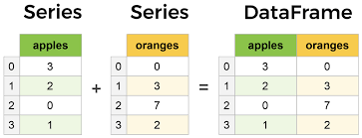
Data Manipulation with
Pandas is a fast, powerful, flexible and easy to use open-source data analysis and manipulation tool.
Pandas is a newer package built on top of NumPy and provides an efficient implementation of a DataFrame.
https://encrypted-tbn0.gstatic.com/images?q=tbn:ANd9GcRIlM018KLATJ5zOpUVq0dZmuBCUeBQRts0Ig&usqp=CAU

Slide 4
Introducing Pandas Objects
Pandas objects can be thought of as enhanced versions of NumPy structured arrays in which the rows and columns are identified with labels rather than simple integer indices
There are three fundamental Pandas data structures:
Series
DataFrame
Index.

Slide 5
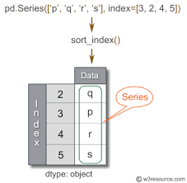
The Pandas Series Object
A Pandas Series is a one-dimensional array of indexed data.
The Series wraps both a sequence of values and a sequence of indices, which we can access with the values and index attributes.

Slide 6
The Pandas DataFrame Object
The next fundamental structure in Pandas is the DataFrame.
The DataFrame can be thought of either as a generalization of a NumPy array, or as a specialization of a Python dictionary.
DataFrame as a generalized NumPy array
If a Series is an equivalent of a one-dimensional array with flexible indices, a DataFrame is an equivalent of a two-dimensional array with both flexible row indices and flexible column names.

Slide 7
Creating Series from simple datatypes
Creating a Pandas Series
The Pandas Series can be defined as a one-dimensional array that can store various data types. We can easily convert the list, tuple, and dictionary into series using "series' method.
The row labels of series are called the index. A Series cannot contain multiple columns. It has the following parameter:
data
index
dtype
copy

Slide 8
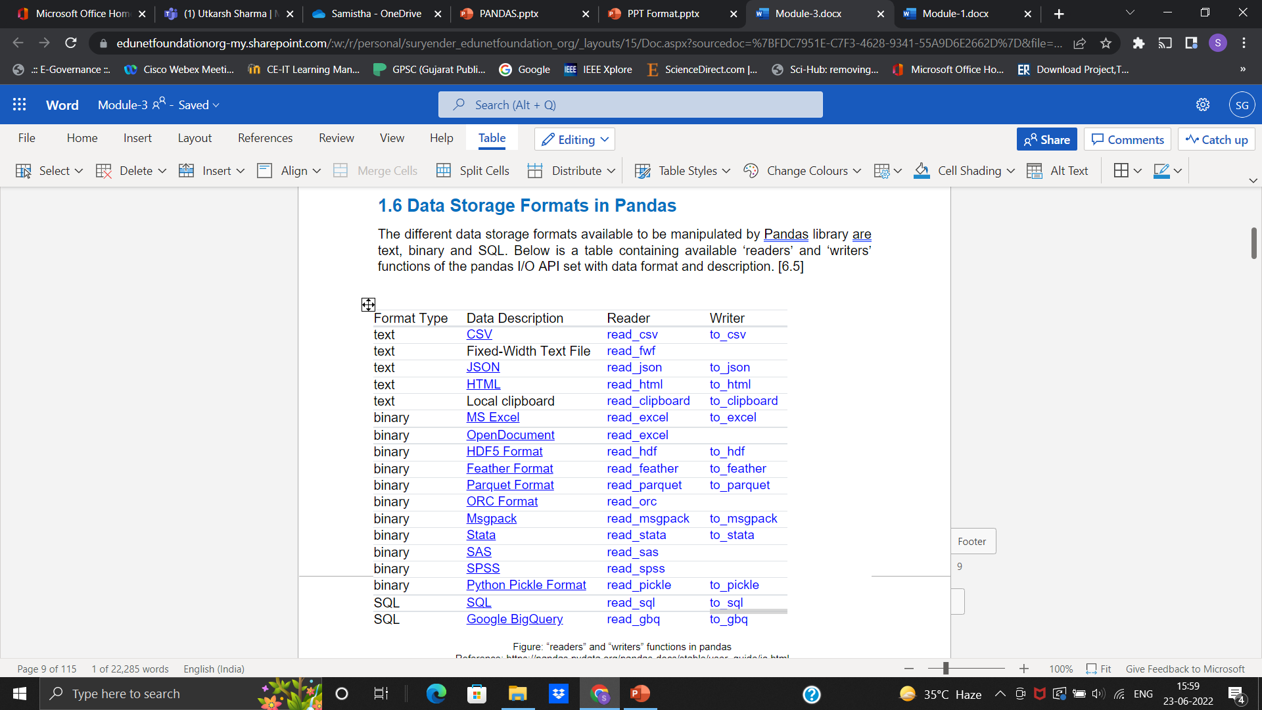
Data Storage Formats in Pandas
The different data storage formats available to be manipulated by Pandas library are text, binary and SQL.

Slide 9
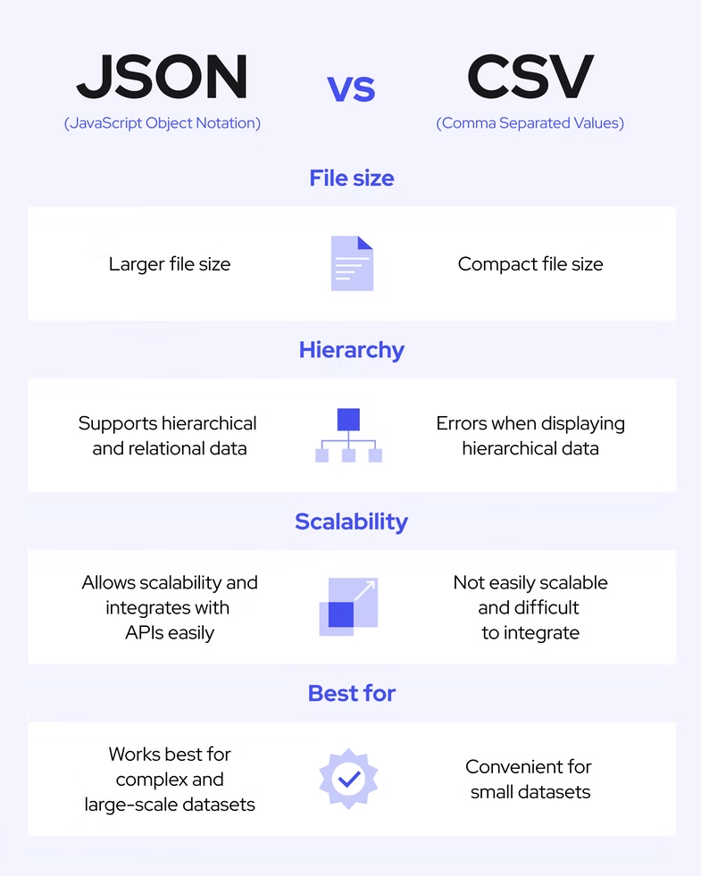
CSV file and JSON file
What is CSV file?
A CSV is a comma-separated values file, which allows data to be saved in a tabular format.
CSV files can be used with many spreadsheets program, such as Microsoft Excel or Google Spreadsheets.
They differ from other spreadsheet file types because you can only have a single sheet in a file, they cannot save cell, column, or row. Also, you cannot save formulas in this format.

Slide 10
​
Why are .CSV files used?​
CSV files are plain-text files, making them easier for the website developer to create​
Since they're plain text, they're easier to import into a spreadsheet or another storage database, regardless of the specific software you're using.​
To better organize large amounts of data.​

Slide 11
How do I save CSV files?
Under the "File name" section in the "Save As" tab, you can select "Save as type" and change it to "CSV (Comma delimited) (*.csv).​

Slide 12
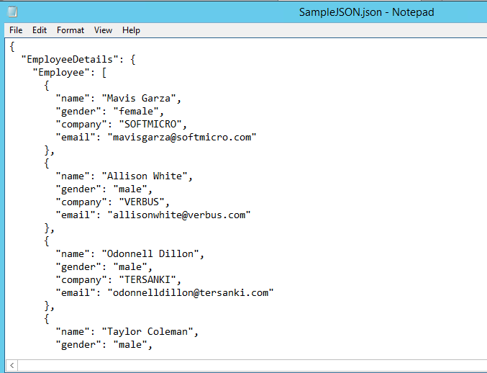
What is a JSON file?
A JSON file is a file that stores simple data structures and objects in JavaScript Object Notation (JSON) format, which is a standard data interchange format.​​
Structures of JSON​
JSON supports two widely used (amongst programming languages) data structures.
A collection of name/value pairs. ​
An ordered list of values.​
https://social.technet.microsoft.com/wiki/cfs-filesystemfile.ashx/__key/communityserver-wikis-components-files/00-00-00-00-05/0020.3.png

Slide 13
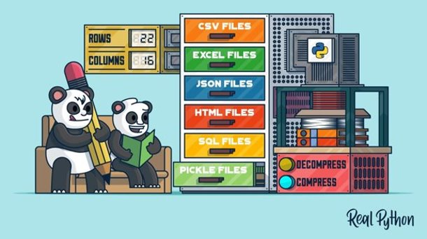
Reading data from files​
Reference: https://realpython.com/pandas-read-write-files

Slide 14
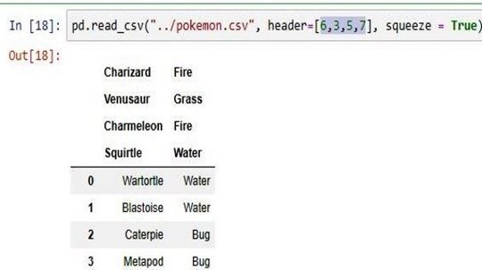
Load CSV files to Python Pandas​
The basic process of loading data from a CSV file into a Pandas DataFrame is achieved using the “read_csv” function in Pandas.​
pd.read_csv(path/xyz.csv)

Slide 15
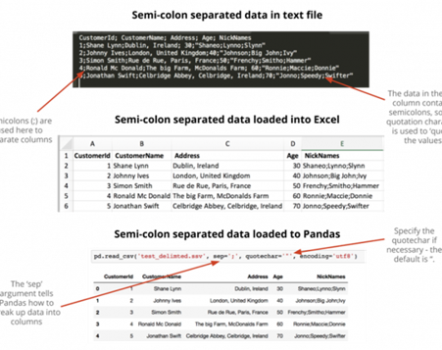
Delimiters in Text Fields – Quote char​
The quote character can be specified in Pandas read_csv using the quote char argument. ​
Reference: https://www.shanelynn.ie/python-pandas-read-csv-load-data-from-csv-files​

Slide 16
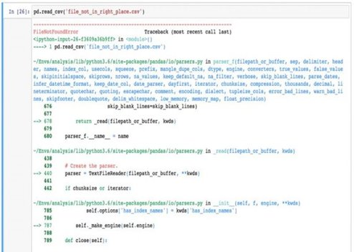
Python – Paths, Folders, Files​
When you specify a filename to Pandas.read_csv, Python will look in your “current working directory“.​
Reference: https://www.shanelynn.ie/python-pandas-read-csv-load-data-from-csv-files

Slide 17
Pandas CSV File Loading Errors​
FileNotFoundError​
UnicodeDecodeError​
pandas.parser.CParserError​

Slide 18
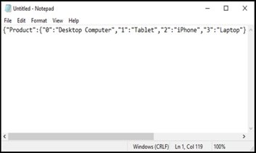

Load JSON files to Python Pandas​
Product​​ | Price​​
Desktop Computer​​ | 700​​
Tablet​​ | 250​​
iPhone​​ | 800​​
Laptop​​ | 1200​​
Step 1: Prepare the JSON String​
Step 2: Create the JSON File.​
Finally, load your JSON file into Pandas DataFrame.​

Slide 19
3 different JSON strings​
Below are 3 different ways that you could capture the data as JSON strings.​
Index orientation​
Values orientation​
Column's orientation​

Slide 20
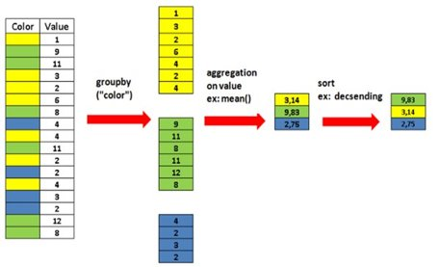
Groupby Methods​
Pandas dataframe.groupby() function is used to split the data into groups based on some criteria. pandas objects can be split on any of their axes.​
Reference: https://towardsdatascience.com/pandas-groupby-explained-453692519d0

Slide 21
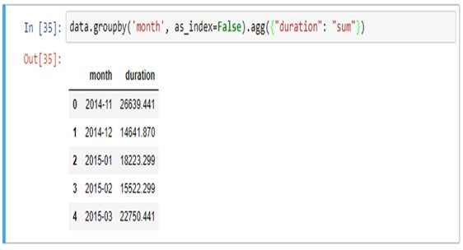
Groupby output format – Series or DataFrame?
As a rule of thumb, if you calculate more than one column of results, your result will be a Data frame.
For a single column of results, the agg function, by default, will produce a Series.

Slide 22
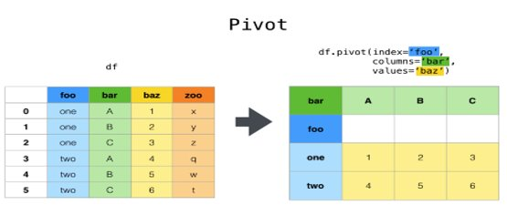
Pivot Tables
It’s a table of statistics that helps summarize the data of a larger table by “pivoting” that data.

Slide 23
How to Build a Pivot Table in Python
In Pandas, we can construct a pivot table using the following syntax:
pandas.pivot_table(data, values=None, index=None, columns=None, aggfunc='mean', fill_value=None, margins=False, dropna=True, margins_name='All', observed=False)

Slide 24
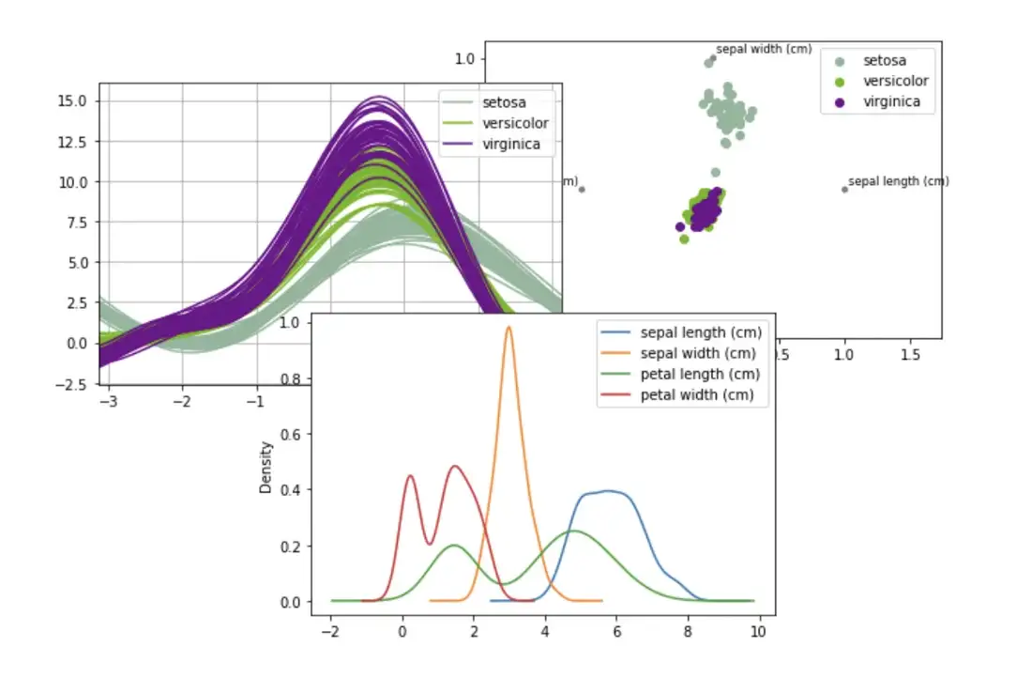
Pandas Plotting
Plotting in pandas utilises the matplotlib API so, to create visualisations, you will need to also import this library alongside pandas.
https://towardsdatascience.com/the-best-pandas-plotting-features-c9789e04a5a0

Slide 25
References
https://pandas.pydata.org/pandas-docs/stable/user_guide/io.html
https://www.bigcommerce.com/ecommerce-answers/what-csv-file-and-what-does-it-mean-my-ecommerce-business/#:~:text=A%20CSV%20is%20a%20comma,Microsoft%20Excel%20or%20Google%20Spreadsheets.
https://fileinfo.com/extension/json
https://www.w3resource.com/JSON/structures.php
https://www.shanelynn.ie/python-pandas-read-csv-load-data-from-csv-files/

